Slide 1
M ANANDHAKRISHNAN
B TECH CHEMICAL ENGG
112721203001
ZOMATO DATA ANALYSIS
3/21/2024 Annual Review

Slide 2
PROJECT TITLE
A Comprehensive Analysis of Zomato Restaurant Data
3/21/2024 Annual Review

Slide 3


AGENDA
1. Introduction & Objectives
2. Data Collection & Preparation
3. Exploratory Data Analysis
4. Restaurant Insights
5. Consumer Behaviour Analysis
6. Regional & Cuisine Trends
7. Geospatial Analysis
8. Business Recommendations
9. Conclusion & Discussion
3/21/2024 Annual Review

Slide 4

PROBLEM STATEMENT
In the vast landscape of the restaurant industry, understanding consumer preferences, regional trends, and factors influencing restaurant success is paramount for both restaurateurs and platforms facilitating food discovery and delivery. Despite the wealth of data available, deriving actionable insights from it remains a challenge.
This project aims to conduct a comprehensive analysis of Zomato restaurant data to uncover hidden patterns, explore culinary trends, and provide valuable insights for stakeholders. By delving into restaurant ratings, consumer behavior, regional variations, and geospatial dynamics, the goal is to offer actionable recommendations for optimizing restaurant performance and enhancing the dining experience.
3/21/2024 Annual Review

Slide 5

PROJECT OVERVIEW
In today's dynamic food landscape, understanding the nuances of consumer preferences, regional culinary trends, and the factors influencing restaurant success is crucial. The project "Exploring Palates" dives deep into the rich dataset provided by Zomato, a leading platform in restaurant discovery and food delivery, to extract meaningful insights that can drive strategic decisions for restaurants and food service platforms alike.
Through a meticulous process of data collection, cleaning, and analysis, this project seeks to uncover hidden patterns and trends within the vast repository of Zomato data. By employing advanced analytical techniques, including exploratory data analysis, sentiment analysis, and geospatial visualization, we aim to provide a comprehensive understanding of the restaurant landscape.
3/21/2024 Annual Review

Slide 6
Key areas of focus include: Restaurant Insights: Identifying top-performing restaurants and chains, analyzing factors influencing restaurant ratings, and uncovering strategies for success. Consumer Behavior Analysis: Delving into user reviews, sentiment analysis, and preferences to understand what drives consumer choices in the dining landscape. Regional and Cuisine Trends: Exploring regional variations in food preferences, identifying popular cuisines, and tracking emerging culinary trends. Geospatial Analysis: Mapping restaurant locations, analyzing density patterns, and uncovering culinary hotspots across different regions.

Slide 7

WHO ARE THE END USERS?
End users of the analysis include:
1. Restaurant owners/managers
2. Chain restaurant executives
3. Independent restaurateurs
4. Zomato and food service platforms
5. Investors and analysts
6. Food industry consultants
3/21/2024 Annual Review

Slide 8

YOUR SOLUTION AND ITS VALUE PROPOSITION
Solutions and Proportions:
1. Menu Optimization & Pricing: 30%
2. Marketing Enhancement: 20%
3. Operational Efficiency: 15%
4. Customer Experience Improvement: 20%
5. Platform Optimization (Zomato): 10%
6. Strategic Planning & Investment: 5%
3/21/2024 Annual Review

Slide 9

THE WOW IN YOUR SOLUTION
The "wow" factor in the solutions derived from the Zomato restaurant data analysis lies in their ability to provide actionable insights that drive tangible improvements across various aspects of the restaurant industry. Here's where the "wow" factor lies in each solution:
Menu Optimization & Pricing:
Marketing Enhancement:
Operational Efficiency:
Customer Experience Improvement:
Strategic Planning & Investment:
3/21/2024 Annual Review
9

Slide 10
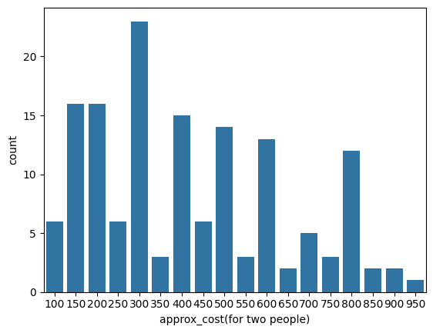
RESULTS
Demo Link
3/21/2024 Annual Review
10

Slide 11
